Slide 1
MongoDB
Fundamentals
Varma Bhupatiraju

Slide 2
What is MongoDb?
MongoDB (from “humongous”) is a
Scalable
High performance
Open source
Schema-free
Document-oriented
NoSQL database

Slide 3
MongoDb vs SQL
SQL (Relational) MongoDB
database database
table collection
row document
The main difference? SQL is relational while MongoDb is document-oriented

Slide 4
How to install MongoDB?
https://www.mongodb.com/download-center#community

Slide 5
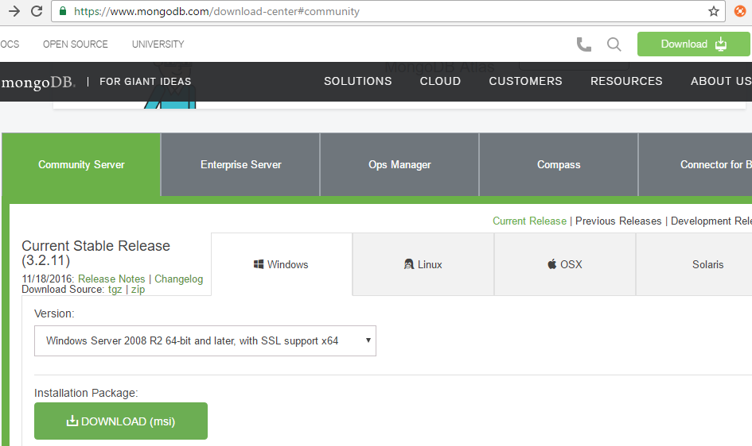
How to install MongoDB?

Slide 6
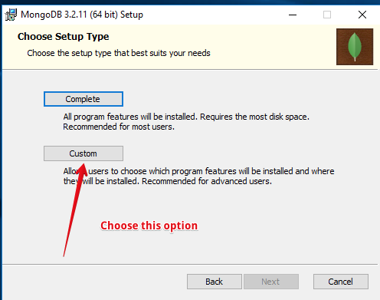
How to install MongoDB?

Slide 7
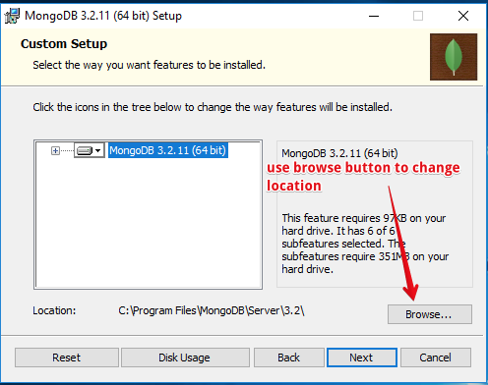
How to install MongoDB?

Slide 8
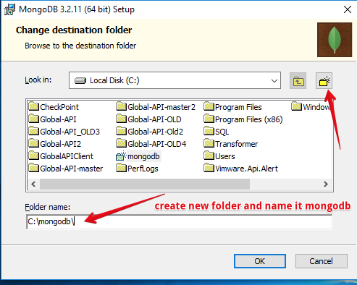
How to install MongoDB?

Slide 9
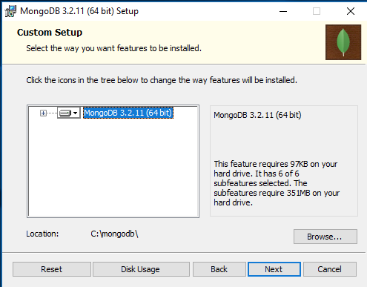
How to install MongoDB?

Slide 10
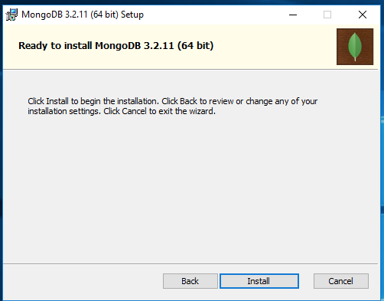
How to install MongoDB?

Slide 11
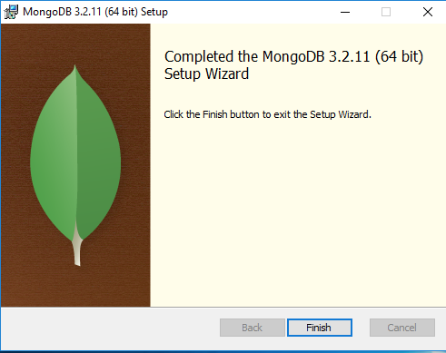
How to install MongoDB?

Slide 12
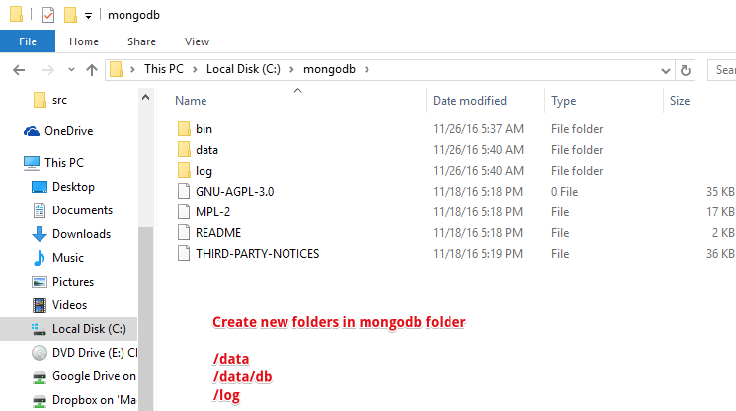
How to install MongoDB?

Slide 13
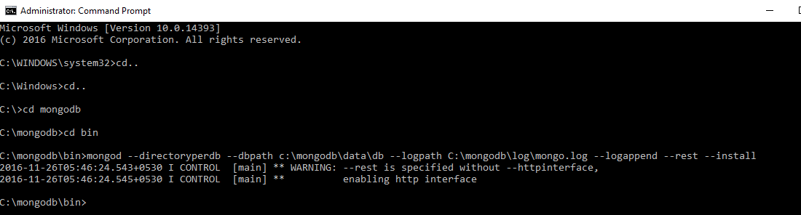
How to install MongoDB?

Slide 14
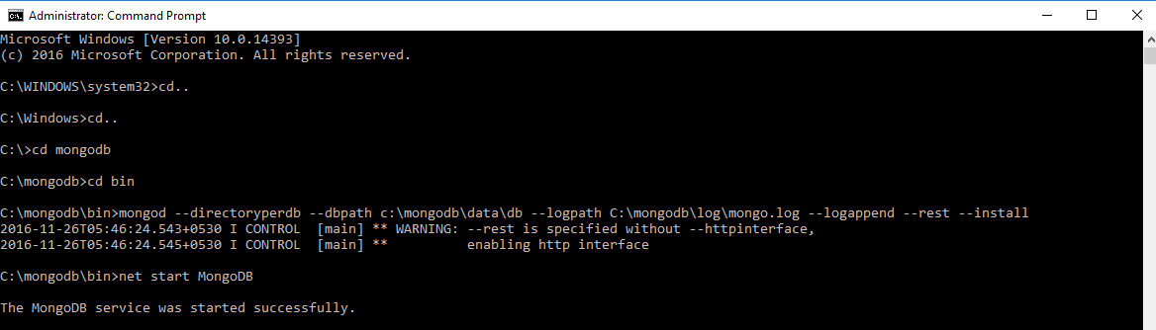
How to install MongoDB?

Slide 15
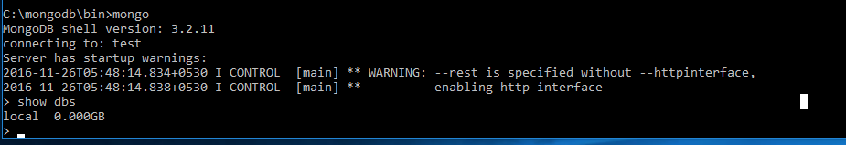
How to install MongoDB?

Slide 16
How to interact with MongoDb?
Mongo Shell
RoboMongo Third Party GUI tool

Slide 17
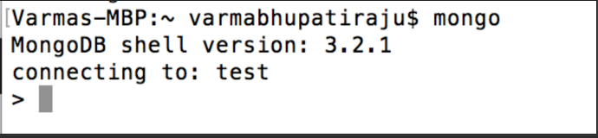
Using Mongo Shell
$ mongo

Slide 18
Using Mongo Shell
Runs javascript
Run Administrative tasks
Run single adhoc command
Useful for
Administrative tasks
Batch Processing
Fixing/Modifying some documents

Slide 19
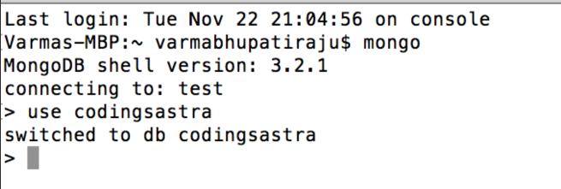
Using Mongo Shell
Switch to another database or create new database
> use codingsastra

Slide 20

Using Mongo Shell
Create collection by creating new document in the collection
>db.students.insert({fname:"Varma",lname:"Bhupatiraju",degree:"MTech"});

Slide 21
Using Mongo Shell
Create collection by creating new document in the collection
>db.students.insert({fname:"Basanth",lname:"Alluri",degree:"MTech",gender:”Male”,age:22});
What did you observe from previous insert?

Slide 22
Using Mongo Shell
Find records in collection using find function
>db.students.find({});

Slide 23
Using Mongo Shell
You can insert more than one record at a time by using db.students.insertMany([{...},{..}])

Slide 24
Using Mongo Shell
Find specific records in collection using find function with arguments
>db.students.find({fname:”Varma”});

Slide 25
Using Mongo Shell
Return the Specified Fields and the _id Field Only
>db.students.find({},{fname:1,lname:1});

Slide 26
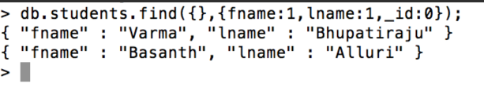
Using Mongo Shell
Return the Specified Fields without the _id Field
>db.students.find({},{fname:1,lname:1,_id:0});

Slide 27
Using Mongo Shell
Update specific document to update fields
>db.students.updateOne({fname:"Varma"},{ $set: {"degree":"BTech"}});

Slide 28
Using Mongo Shell
delete specific document
>db.students.remove({fname:"Varma"});
>db.students.deleteOne({fname:"Varma"}); //added in 3.2
Other delete methods available
>db.students.deleteMany({gender:"Male"}); //added in 3.2

Slide 29
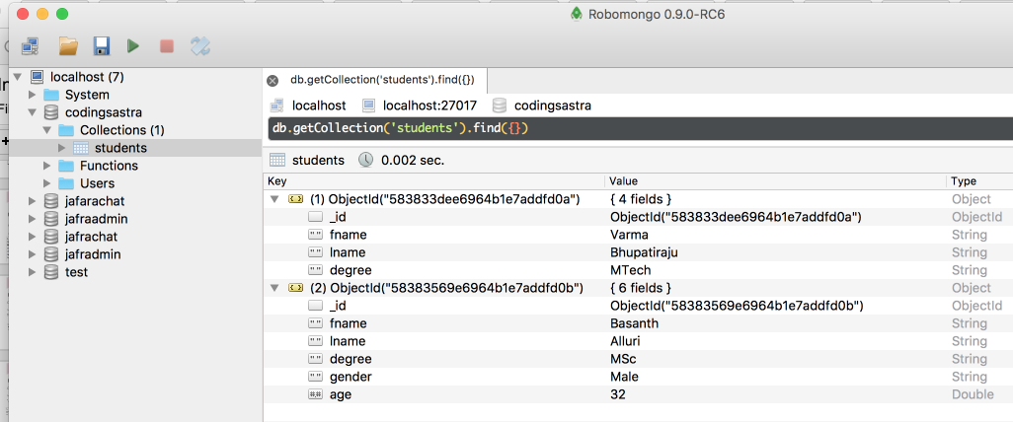
Using RoboMongo

Slide 30
How to write application to get data from MongoDB?
MongoDb provided Client Drivers for several programming languages to connect to MongoDB.
Python
Node.js
C#
Java
Many more..
https://docs.mongodb.com/ecosystem/drivers/

Slide 31
Demo

